Slide 1
Title Layout
Subtitle

Slide 2
Title and Content Layout with List
Add your first bullet point here
Add your second bullet point here
Add your third bullet point here

Slide 3
Two Content Layout with SmartArt
Group A
Task 1
Task 2
Group B
Task 1
Task 2
Group C
Task 1
First bullet point here
Second bullet point here
Third bullet point here

Slide 4
Add a Slide Title - 1

Slide 5
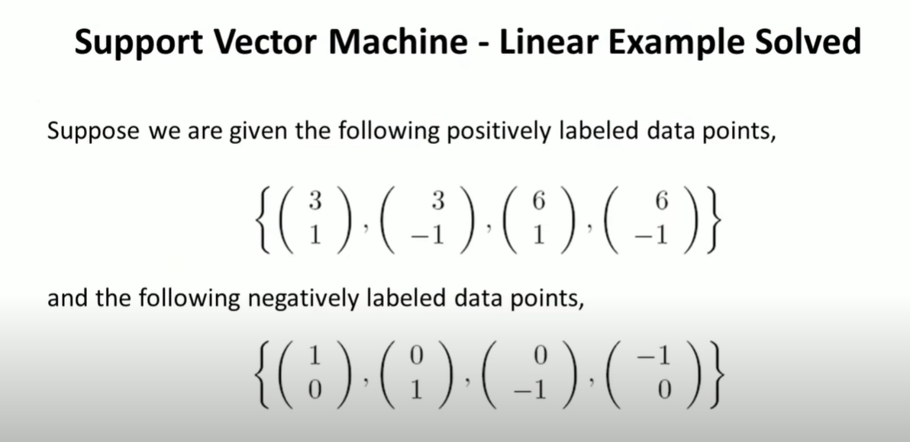
Support Vector Machine | Linear SVM Example

Slide 6
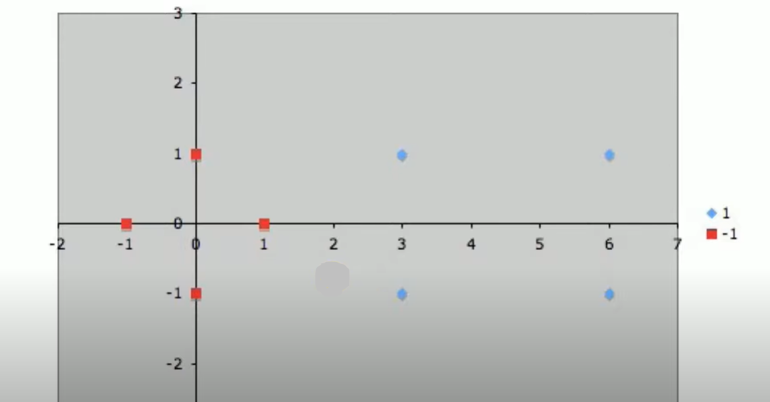

Slide 7
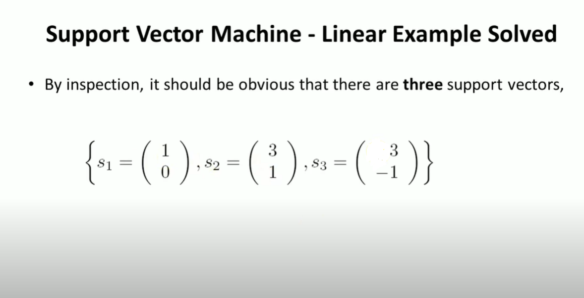

Slide 8
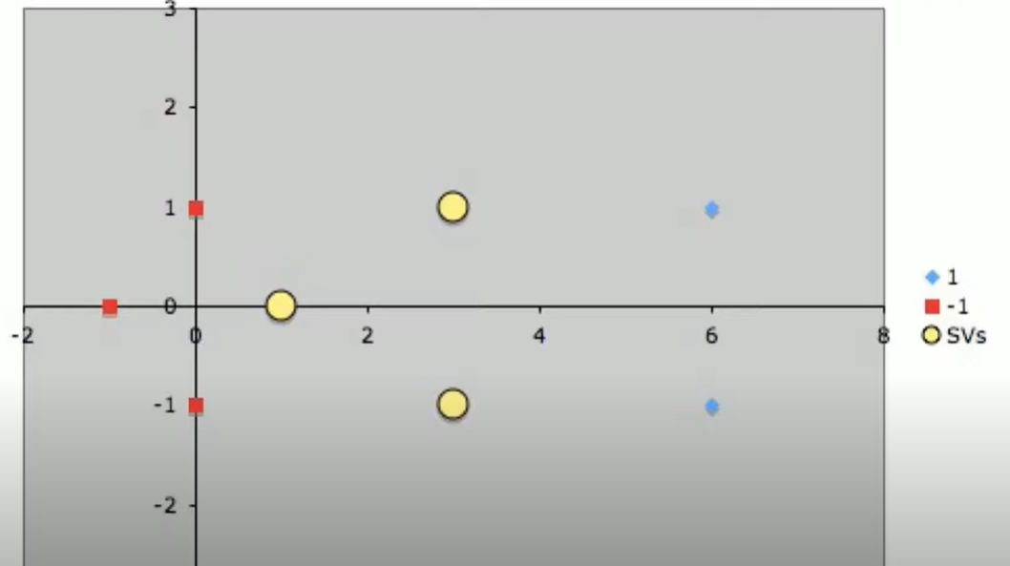

Slide 9
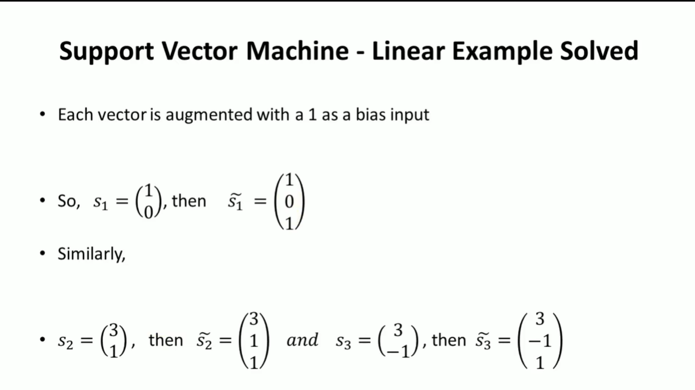

Slide 10
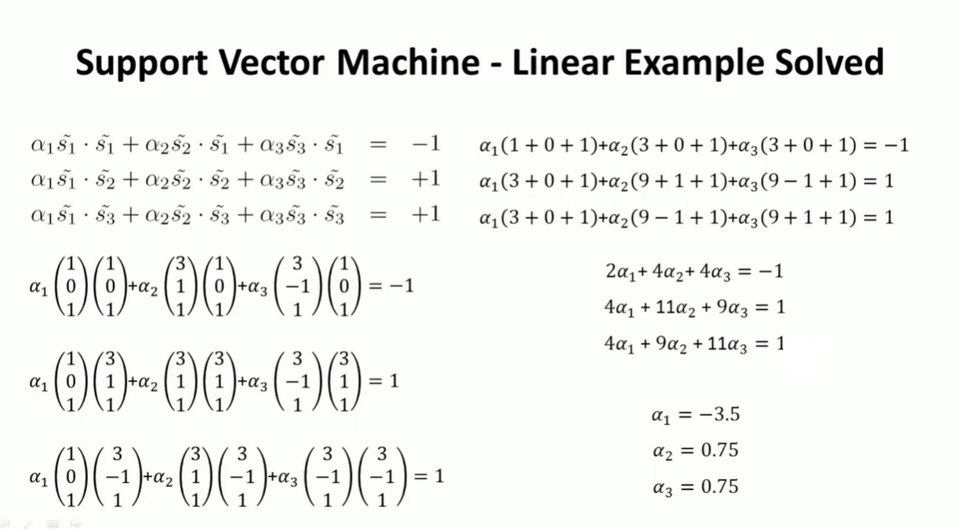

Slide 11
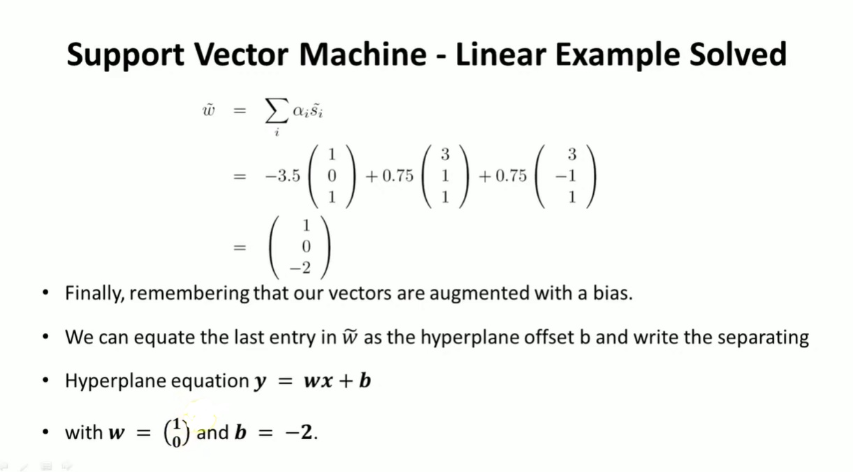

Slide 12
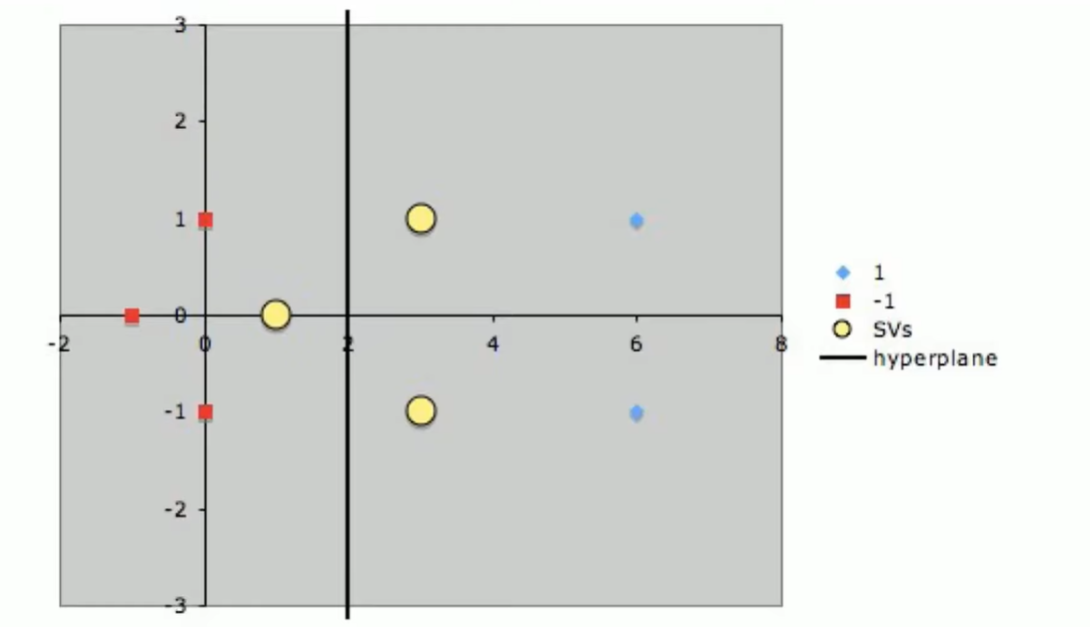

Slide 13
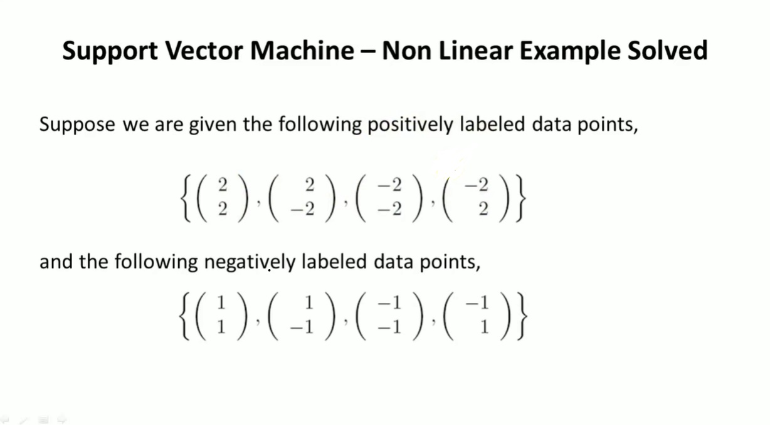
Support Vector Machine | Non-Linear SVM Example

Slide 14
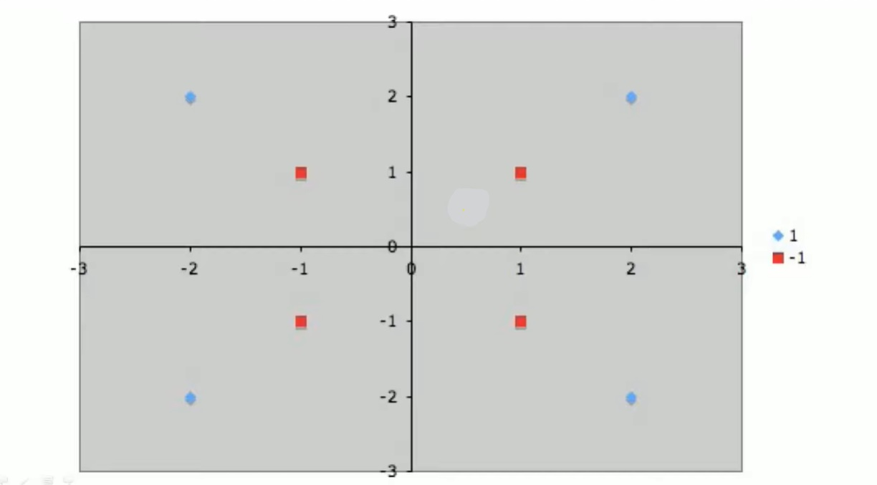

Slide 15
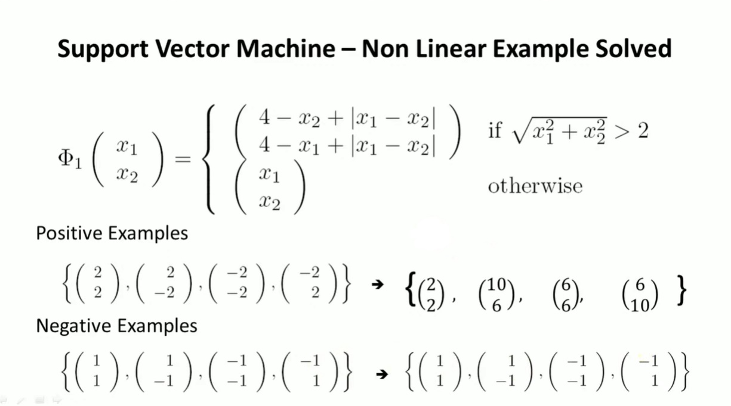

Slide 16
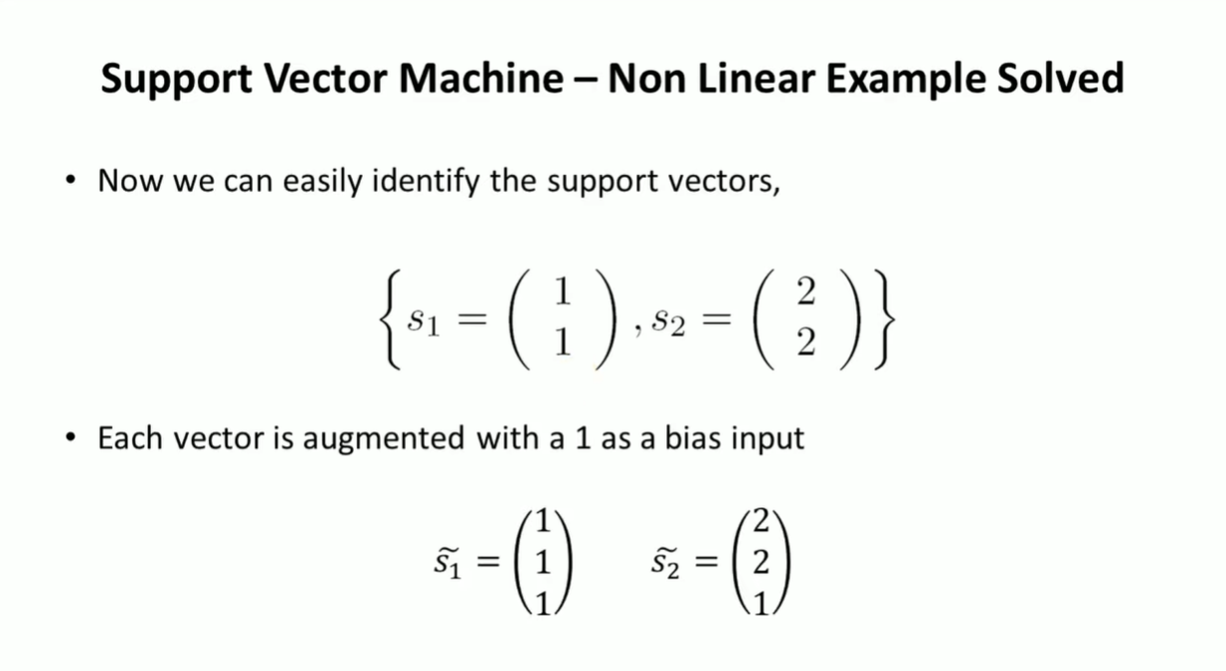

Slide 17
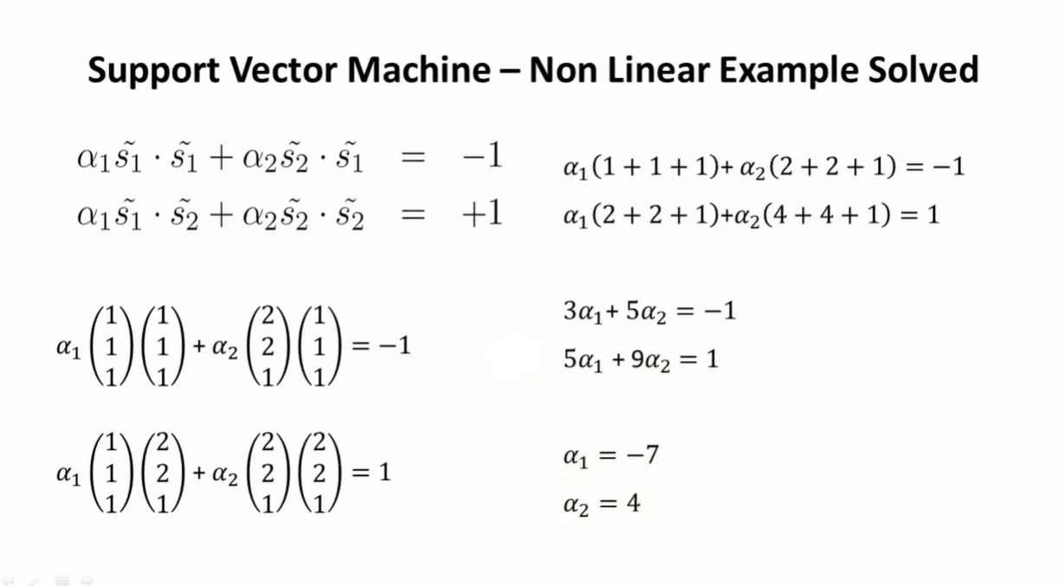

Slide 18
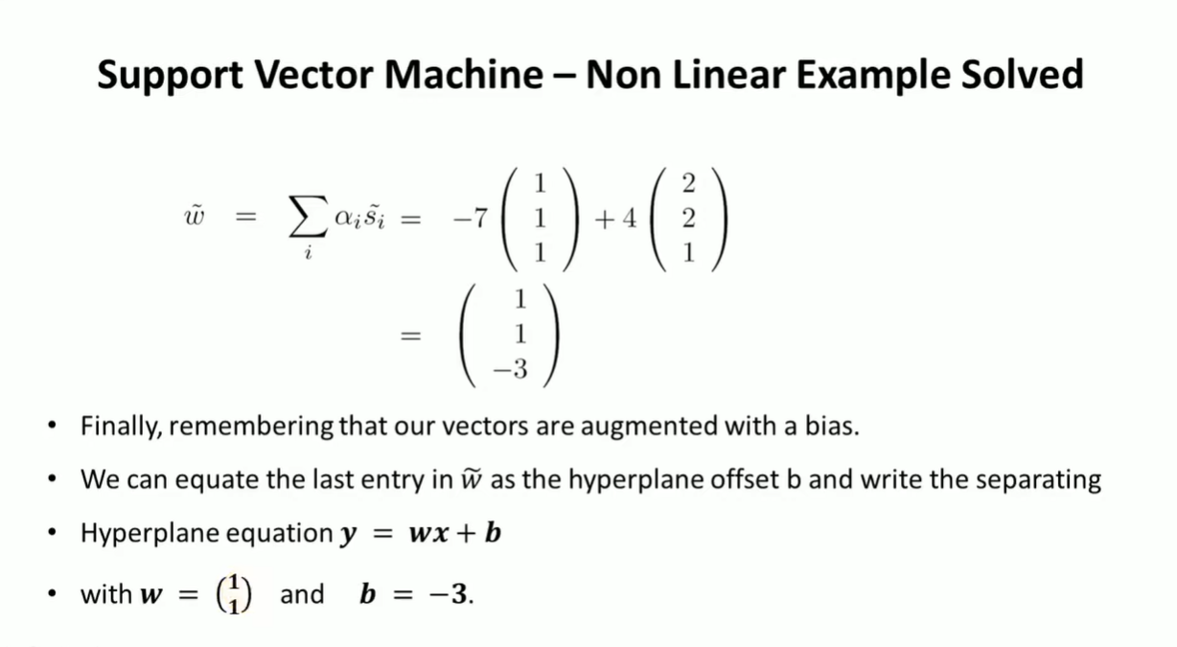

Slide 19
